Slide 1
Focal Prototype
Presentation
Three approaches to the next vision-care decision
MENG 570 Team 5
Fan, Hadley, Haydn, Burak and Qingyi
01
Notes:
Timing: 0:15
Introduce Focal and the team. We built three working experiences to compare where to focus first. This deck accompanies the websites. It does not replace the live demos. Slides 1–3 together take no more than two minutes.
Sources
docs/assignments/prototype-assignment.md
docs/strategy/lean-canvas.pptx, slides 1–2
Logo: assets/brand/focal-lockup.svg, original supplied artwork
Repository: https://github.com/haydn-s/focal-technologies

Slide 2
The vision-care decision between visits
Original problem
Current framing
Routine vision checks can feel difficult to access.
People need a reason to check and a next step they understand.
A quick result has limited value if the person cannot interpret it or act on it.
02
Notes:
Timing: 0:45
Our original Lean Canvas emphasized accessibility, outdated testing and routine monitoring. Discovery widened the problem: the obstacle can be effort, fear of the answer, low urgency, or uncertainty about the next step. This is the current product framing, not a clinical finding. Introduce the three situations: Riley notices possible change, Pat notices a child struggling, and Alex has a DMV visit coming up.
Sources
docs/strategy/lean-canvas.pptx, slides 1–2
docs/research/customer-discovery/presentation.pptx, slides 2, 3, 5, 6, 7; docs/research/customer-discovery/interview-workbook.docx, sections 3B, 3C and the existing Team Final Assessment
Repository: https://github.com/haydn-s/focal-technologies

Slide 3
What discovery changed
Evidence in our discovery work | Response in the prototypes
One real parent already kept detailed exam records. | B focuses on observations and preparation for a conversation.
Real interviewees described different levels of urgency and trust. | A tests historical context. C tests a concrete deadline.
Some real participants questioned the accuracy of informal tests. | We label the limits and test usefulness separately from accuracy.
Our licensing-supervisor evidence came from virtual interviews. | C serves an applicant. Agency acceptance remains unvalidated.
Small discovery sample. Virtual interviews generated hypotheses rather than validating demand.
03
Notes:
Timing: 1:00
Explain the shift without overstating the interviews. The discovery presentation records five virtual and five in-person interviews, with no real licensing supervisor. The small convenience sample challenged universal claims about tracking, trust and urgency. The parent finding is from a real interview. Alex's detailed DMV scenario and Lisa's institutional scenario are virtual-persona evidence. C's deadline is therefore a bet to test with real applicants. Do not present the personas as confirmed market segments. End the problem section at two minutes total.
Sources
docs/research/customer-discovery/presentation.pptx, slides 2, 3, 5, 6, 7; docs/research/customer-discovery/interview-workbook.docx, sections 3B, 3C and the existing Team Final Assessment
Repository: https://github.com/haydn-s/focal-technologies

Slide 4
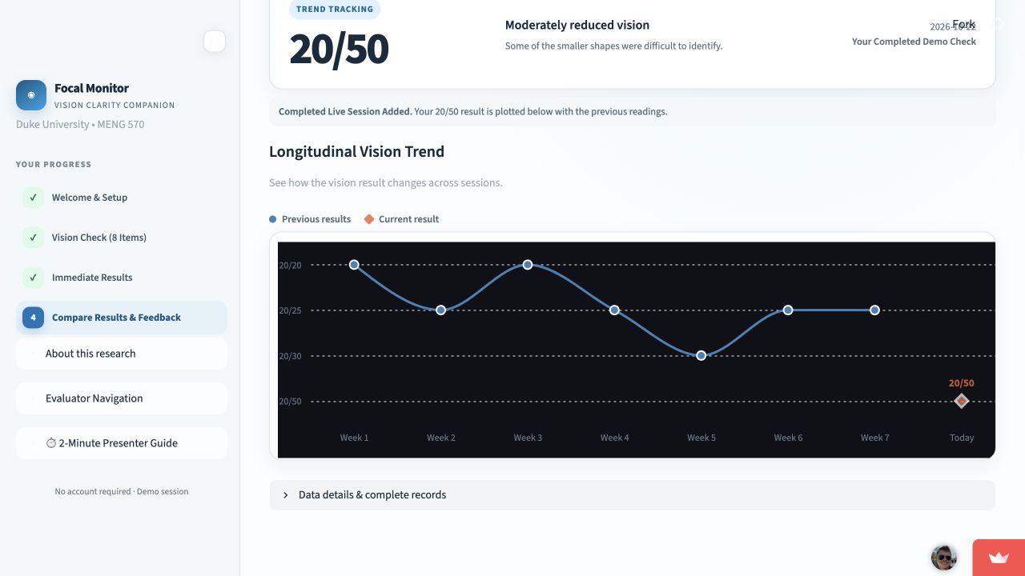
A Focal Monitor
Routine-Check Riley
Does history make the same result more useful?
The test
Compare Single Result and Trend Tracking after one completed check.
Proposed signal: at least 3 of 5 Riley-like participants explain a format preference.
Illustrative acuity labels. Fictional history. Clinical accuracy and repeat use remain untested.
04
Notes:
Timing: 2:00
Riley wears corrective lenses and wants to understand change between exams. The hypothesis is that historical context will feel more useful than an isolated result. Explain the eight-item interaction, then the same current result in two formats. Historical records are fictional, clearly separate from the completed demo session. Initial comparison order is randomized and feedback requires both views. Ask for preference and the reason, including equal, neither or uncertain answers. A pilot signal is at least three of five Riley-like participants stating a format preference and explaining why. That is a proposed decision aid, not a finding. A flat preference, confusion between fictional and current data, or a preference for the single result would challenge the bet. Stated preference does not establish return behavior. A previous isolated result may anchor the comparison. The acuity-style label is illustrative and uncalibrated.
Sources
prototypes/prototype-a-riley-vision-tracking/README.md and app.py
https://focal-demo-a.streamlit.app/
Screenshot: actual public demo, captured October 21, 2026. Test responses were made for the demonstration.
Repository: https://github.com/haydn-s/focal-technologies

Slide 5
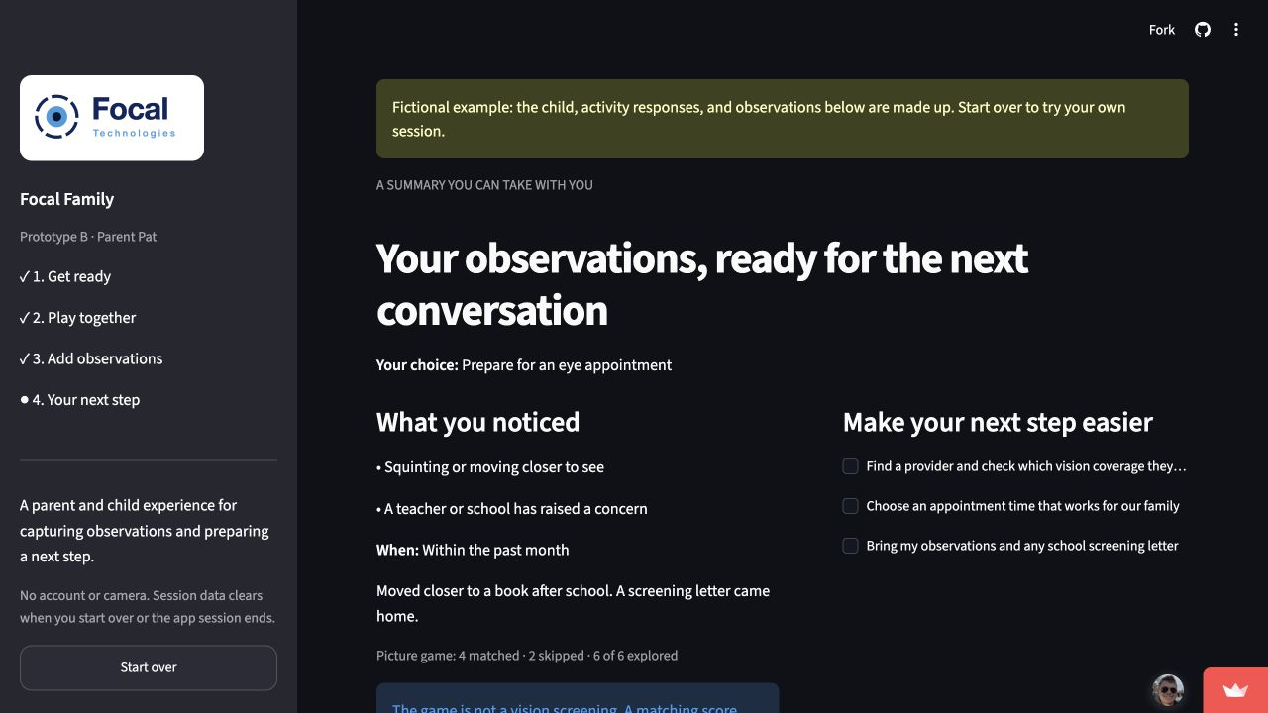
B Focal Family
Parent Pat
Can a shared activity help Pat prepare a next step?
The test
Practice, play six pictures, capture observations and prepare a note.
Proposed signal: 4 of 5 finish unaided and 3 of 5 choose appointment or school preparation.
Picture matching supports interaction only. The parent chooses the next step.
05
Notes:
Timing: 2:00
Pat is a working parent of children aged four to ten. One real parent already tracked exam records and described children memorizing a home chart. B explores a shared activity and preparation rather than adding another tracking dashboard. Children learn a practice picture, then complete or skip six fixed-size pictures with breaks available. The parent records what they noticed, chooses a next step, adds questions and edits a message. The app never infers a care recommendation from matching performance. Proposed pilot signals are four of five parents completing unaided and three of five choosing appointment or school-contact preparation. Ask how clear their next step is and what could prevent follow-through. Participants may find the activity irrelevant or the note unhelpful, which would challenge the bet. A download request or expressed intention does not prove an appointment happened. The fictional example is labeled and must be analyzed separately.
Sources
prototypes/prototype-b-parent-guided-check/README.md, app.py and demo.py
docs/research/customer-discovery/presentation.pptx, slides 2, 3, 5, 6, 7; docs/research/customer-discovery/interview-workbook.docx, sections 3B, 3C and the existing Team Final Assessment
https://focal-demo-b.streamlit.app/
Screenshot: built-in fictional example on the public demo, captured October 21, 2026.
Repository: https://github.com/haydn-s/focal-technologies

Slide 6
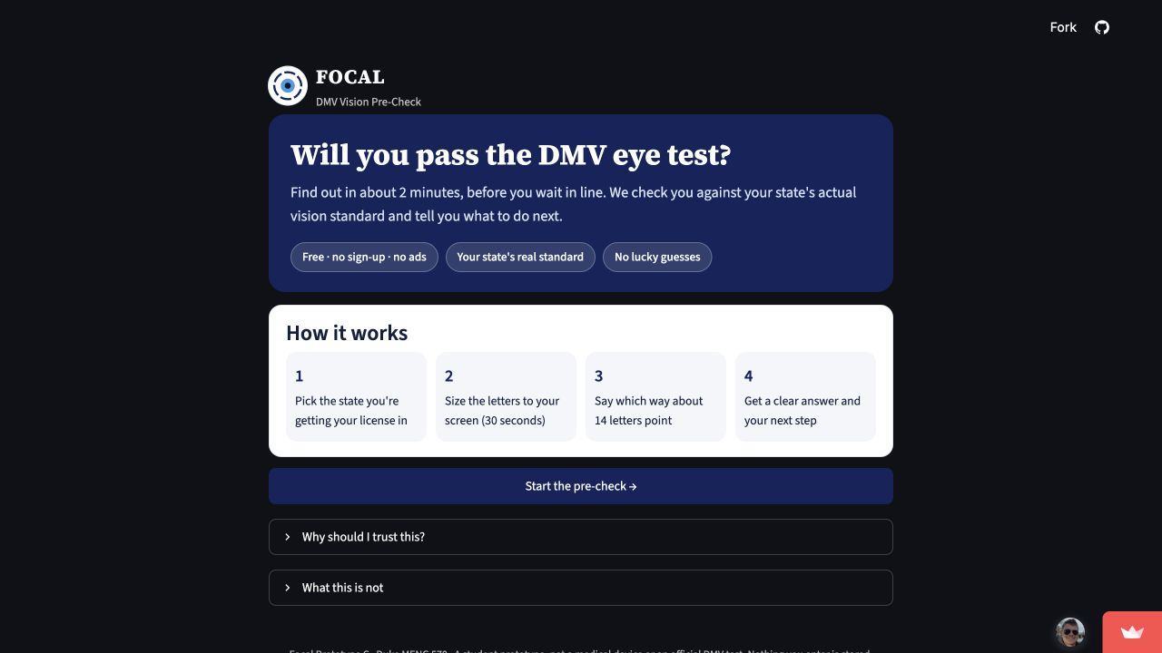
C Focal DMV Pre-Check
Anxious Applicant Alex
Does a DMV deadline make Alex more likely to act?
The test
Use a state-specific practice result to prepare for the next step.
Proposed signals: 70% understand the result and 60% would likely use it before a DMV visit.
Student practice prototype. Official DMV outcomes and clinical accuracy remain unvalidated.
06
Notes:
Timing: 2:00
Alex has a first license or renewal coming up. The hypothesis is that a concrete deadline and a contextual practice result will motivate use more than an unexplained score. The app includes a state picker, card-based screen sizing, a chosen viewing distance, randomized letters, one honest retake, and a next-step plan. Reminders are simulated and the parent message is a draft. Proposed signals include seventy percent reporting that they understand the practice result and sixty percent of deadline-relevant people saying they would likely use it. For people shown the see-an-eye-doctor route, the existing scope proposes fifty percent stated intent to book. Confirm these pilot rules with the team. There is no controlled general-score comparator in this app, so its preference question cannot establish a causal advantage. Alex said the road test worried him more than the vision screening in the virtual interview. Low urgency among real applicants would challenge the bet. This is not an official DMV test or clinical prediction of passing.
Sources
prototypes/prototype-c-alex-dmv-precheck/README.md and app.py
docs/research/customer-discovery/presentation.pptx, slides 2, 3, 5, 6, 7; docs/research/customer-discovery/interview-workbook.docx, sections 3B, 3C and the existing Team Final Assessment
docs/strategy/lean-canvas.pptx, slides 1–2
https://focal-demo-c.streamlit.app/
Screenshot: actual public welcome page, captured October 21, 2026.
Repository: https://github.com/haydn-s/focal-technologies

Slide 7
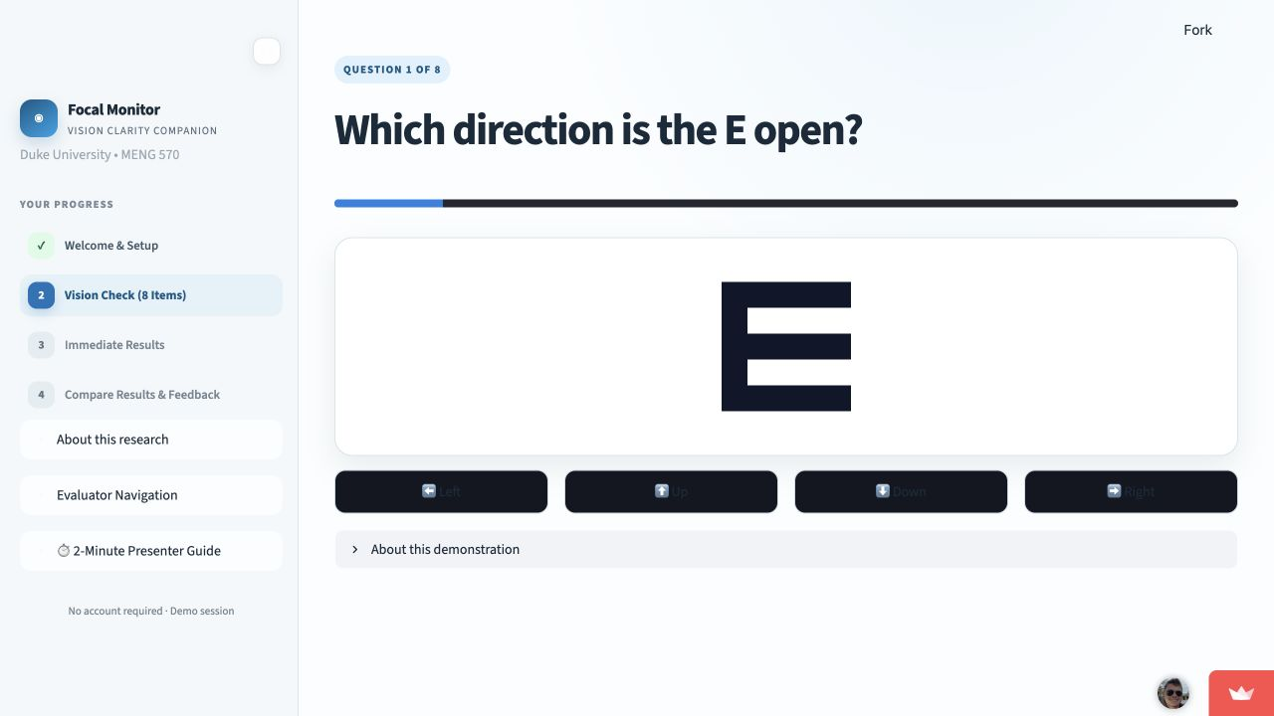
Live demo A
Focal Monitor
focal-demo-a.streamlit.app
Eight responses
One result in two views
Preference and reason
What does history add to the decision?
07
Notes:
Timing: 2:00
0:00–0:20 Open the published app in a fresh tab and introduce Riley.
0:20–0:55 Complete the eight E responses with the demo interaction.
0:55–1:30 Open Compare Results, visit both Single Result and Trend Tracking, and point out the fictional history versus the completed session.
1:30–2:00 Show the neutral feedback and reset path. Do not describe the demo acuity label as a measurement. Keep a separately prepared completed session available if answering takes too long. If the live app fails, use the screenshot to describe the intended journey and move on.
Sources
prototypes/prototype-a-riley-vision-tracking/README.md and app.py
https://focal-demo-a.streamlit.app/
Image: actual public demo screenshot captured October 21, 2026. Screenshots illustrate the interface and are not clinical evidence.
Repository: https://github.com/haydn-s/focal-technologies

Slide 8
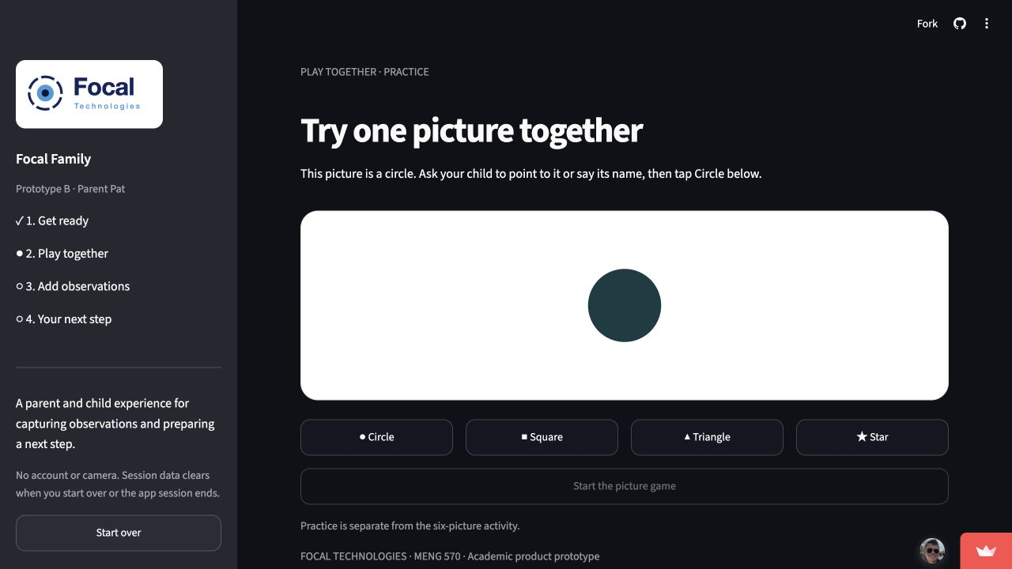
Live demo B
Focal Family
focal-demo-b.streamlit.app
Practice and picture activity
Parent observations
Editable note and next step
Can Pat explain what to do after the activity?
08
Notes:
Timing: 2:00
0:00–0:20 Select a label and age group, then complete the practice circle.
0:20–0:55 Explore the six pictures, skip one, and briefly pause and resume.
0:55–1:20 Record an observation and choose appointment or school preparation.
1:20–1:45 Add a question or edit the message, then show the summary download.
1:45–2:00 Show clarity and barrier feedback and the reset. Nothing is booked or sent. The built-in fictional example is a labeled backup, not a participant result. If the live app fails, use the screenshot to explain the intended journey and move on.
Sources
prototypes/prototype-b-parent-guided-check/README.md, app.py and demo.py
https://focal-demo-b.streamlit.app/
Image: actual public demo screenshot captured October 21, 2026. Screenshots illustrate the interface and are not clinical evidence.
Repository: https://github.com/haydn-s/focal-technologies

Slide 9
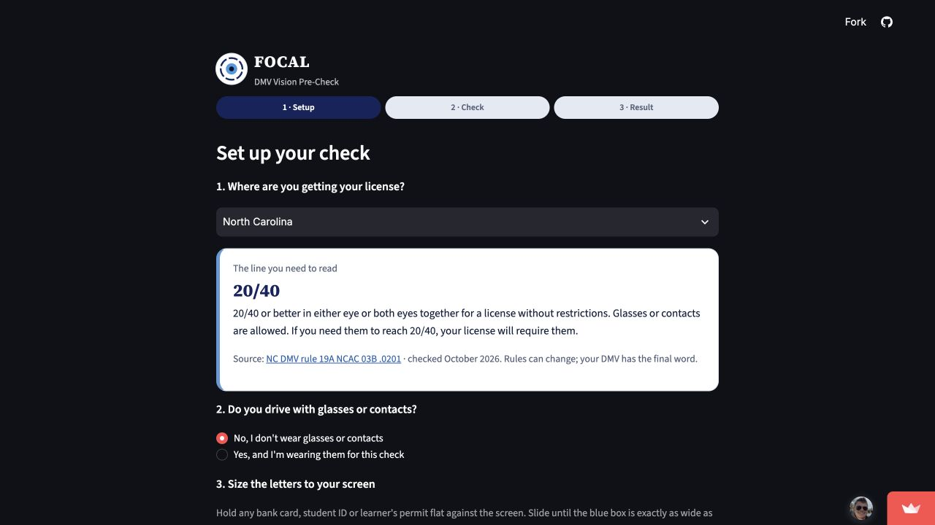
Live demo C
Focal DMV Pre-Check
focal-demo-c.streamlit.app
State and screen setup
Practice check
Result and action plan
Does the deadline make the next step feel relevant?
09
Notes:
Timing: 2:00
0:00–0:30 Select a state, show the linked source, match the card width, choose distance and complete the setup checklist.
0:30–1:15 Answer the letters, using Can't tell when appropriate. Show the result of this attempt without forcing a favorable outcome.
1:15–1:45 Explain the practice verdict and next-step plan. Point out the simulated reminder and the message draft.
1:45–2:00 Show the feedback path. A separately prepared completed session can serve as a backup. The app does not certify eligibility or predict the official result. If the live app fails, use the screenshot to explain the intended journey and move on.
Sources
prototypes/prototype-c-alex-dmv-precheck/README.md and app.py
https://focal-demo-c.streamlit.app/
Image: actual public demo screenshot captured October 21, 2026. Screenshots illustrate the interface and are not clinical evidence.
Repository: https://github.com/haydn-s/focal-technologies

Slide 10
The core scope we prioritized
Demo | Core feature | Value | Effort | Complexity | Proposed success signal
A | One result in two formats | High | Medium | Medium | 3 of 5 explain a format preference after viewing both.
B | Parent observations and preparation | High | Low to medium | Low to medium | 4 of 5 finish unaided. 3 of 5 select appointment or school preparation.
C | Deadline-specific practice and plan | High | Medium | Medium | 70% understand the result. 60% state likely use before a DMV visit.
Estimates apply to the scoped core flows. Pilot thresholds are proposed targets, with small samples.
10
Notes:
Timing: 1:00
Explain prioritization using value, effort, complexity and success signals. These are qualitative team estimates synthesized from the per-prototype scope cards. A's medium work protects a fair format comparison. B keeps observation capture simple and spends additional effort on note editing and pause state. C spends effort on setup and communicating the result. All three keep feedback visible because the goal is learning. The numerical signals come from the documented proposed scope rules. They are not observed results or statistically powered thresholds. They also do not make the three personas directly comparable.
Sources
prototypes/prototype-a-riley-vision-tracking/README.md and app.py
prototypes/prototype-b-parent-guided-check/README.md, app.py and demo.py
prototypes/prototype-c-alex-dmv-precheck/README.md and app.py
Repository: https://github.com/haydn-s/focal-technologies

Slide 11
Deliberate cuts and their tradeoffs
Kept for this experiment | Deferred and the implication
A: a repeatable result-format comparison | Accounts and persistent history. We cannot establish long-term use yet.
B: a parent-controlled observation summary | Vision measurement and real booking. We test preparation rather than completed care.
C: a practice check and contextual plan | Official acceptance and real reminders. We test relevance and stated intent.
Clinical validation remains separate work for all three approaches.
11
Notes:
Timing: 0:45
These cuts preserve the feature each prototype needs to test. Explain the cost: A cannot show actual retention, B cannot show that an appointment happened, and C cannot claim official acceptance or reminder-driven follow-through. Adding every integration now would increase effort while muddying the comparison. Clinical calibration and validation need their own work before anyone relies on the apps as measurements.
Sources
prototypes/prototype-a-riley-vision-tracking/README.md and app.py
prototypes/prototype-b-parent-guided-check/README.md, app.py and demo.py
prototypes/prototype-c-alex-dmv-precheck/README.md and app.py
Repository: https://github.com/haydn-s/focal-technologies

Slide 12
What the comparison can change
If feedback favors | Product direction to explore | Next test with real users
A: historical context | Ongoing personal monitoring | Repeated use over weeks, beyond a stated format preference.
B: family preparation | Parent and pediatric workflow | Whether parents use the note and complete their chosen follow-up.
C: a deadline and plan | A focused applicant entry point | Use before real DMV visits and separate discovery with agency staff.
Class preference informs the next experiment. Persona-specific evidence must support the direction.
12
Notes:
Timing: 0:45
We have not chosen a winner or collected classroom results yet. A favorable vote identifies the next direction to investigate, not proof of market demand. Recruit the relevant persona for each follow-up and observe behavior. Capture completion time, help needed, comprehension and reasons. Keep fictional examples separate from participant sessions. Do not equate usefulness with clinical validity or download intent with action. If classroom preference conflicts with persona evidence, explain the conflict and discuss a reasoned alternative with the teaching team, following the assignment.
Sources
docs/assignments/prototype-assignment.md
prototypes/prototype-a-riley-vision-tracking/README.md and app.py
prototypes/prototype-b-parent-guided-check/README.md, app.py and demo.py
prototypes/prototype-c-alex-dmv-precheck/README.md and app.py
Repository: https://github.com/haydn-s/focal-technologies

Slide 13
Which would you actually use?
A
Focal Monitor
A result in the context of change over time
B
Focal Family
A shared activity and a prepared parent conversation
C
Focal DMV Pre-Check
A practice result before a specific deadline
13
Notes:
Timing: 0:30, then class vote
Ask the class to vote for the prototype they would actually use and capture the reason. Do not show a predicted or invented vote total. Record the tally after the class votes. The assignment expects us to move forward with the voted option unless we bring the teaching team a reasoned case for another version.
Sources
docs/assignments/prototype-assignment.md
Repository: https://github.com/haydn-s/focal-technologies

Slide 14
Prototype links
A Focal Monitor
https://focal-demo-a.streamlit.app/
B Focal Family
https://focal-demo-b.streamlit.app/
C Focal DMV Pre-Check
https://focal-demo-c.streamlit.app/
Repository and team prompt log
14
Notes:
Timing: Backup slide, outside the main talk
All three public landing pages loaded during preparation on October 21, 2026. The team still needs two human rehearsals per demo, a final public full-flow check and Canvas submission. This slide provides actual links, not a submission receipt. Detailed evidence and implementation sources appear in the notes of the relevant slides.
Sources
https://focal-demo-a.streamlit.app/
https://focal-demo-b.streamlit.app/
https://focal-demo-c.streamlit.app/
https://github.com/haydn-s/focal-technologies/blob/main/prompts.md
docs/assignments/prototype-assignment.md
Repository: https://github.com/haydn-s/focal-technologies

